Slide 1

Setting up your optimization problem
Gradient Checking
deeplearning.ai

Slide 2
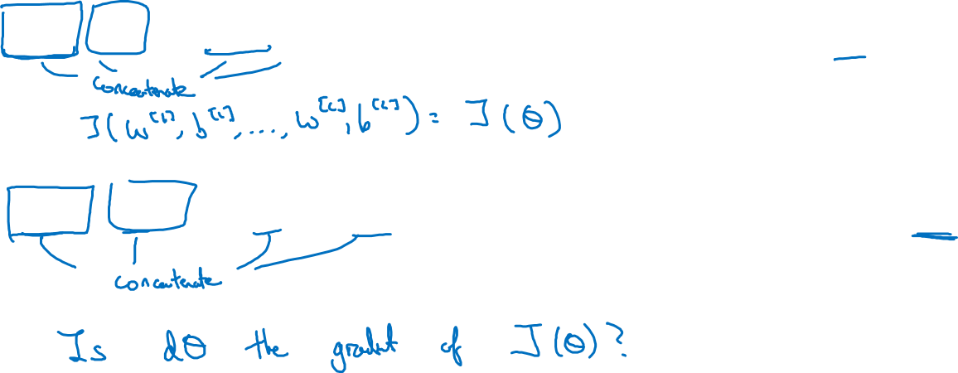
Gradient check for a neural network
Take $W^{\left[1\right]},b^{[1]},…,W^{\left[L\right]},b^{\left[L\right]}$ and reshape into a big vector $θ.$
Take ${dW}^{\left[1\right]},{db}^{[1]},…,{dW}^{\left[L\right]},{db}^{\left[L\right]}$ and reshape into a big vector $dθ.$

Slide 3
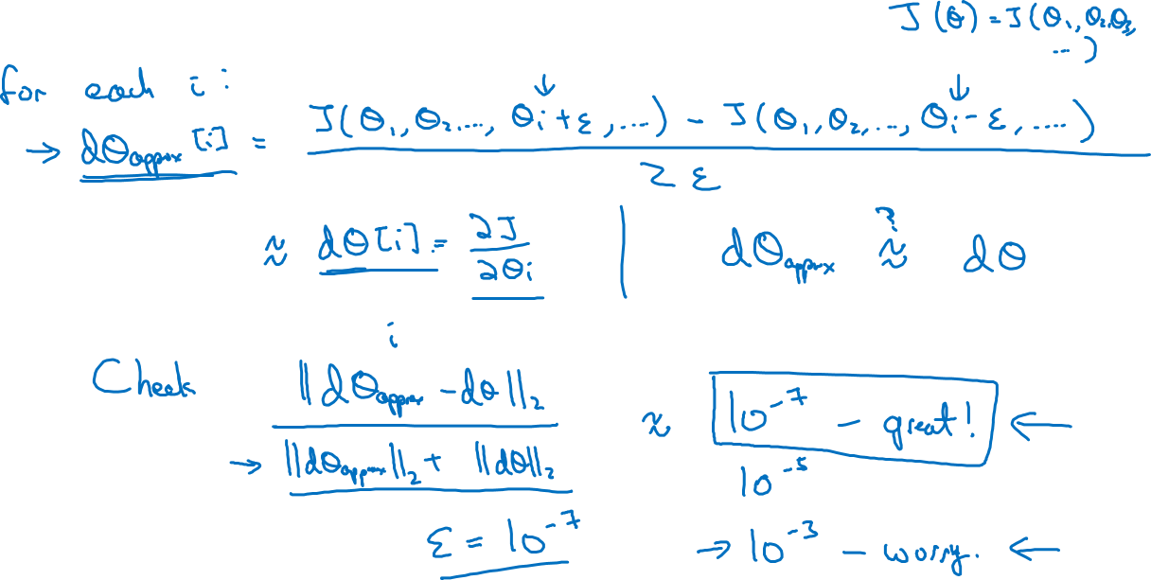
Gradient checking (Grad check)

Slide 4
Setting up your optimization problem
Gradient Checking
implementation notes
deeplearning.ai

Slide 5
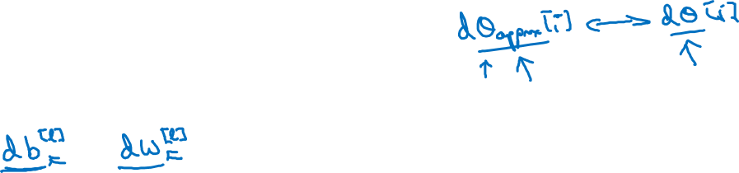
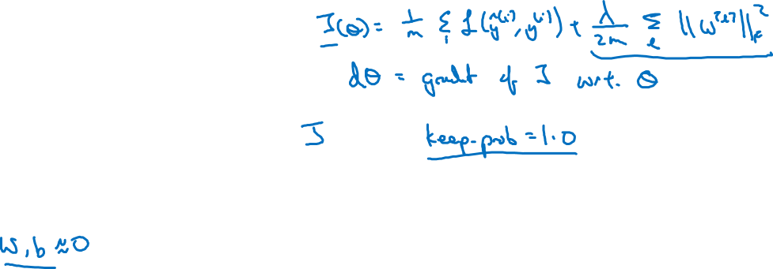
Gradient checking implementation notes
- Don’t use in training – only to debug
- If algorithm fails grad check, look at components to try to identify bug.
- Remember regularization.
- Doesn’t work with dropout.
- Run at random initialization; perhaps again after some training.

